Slide 1
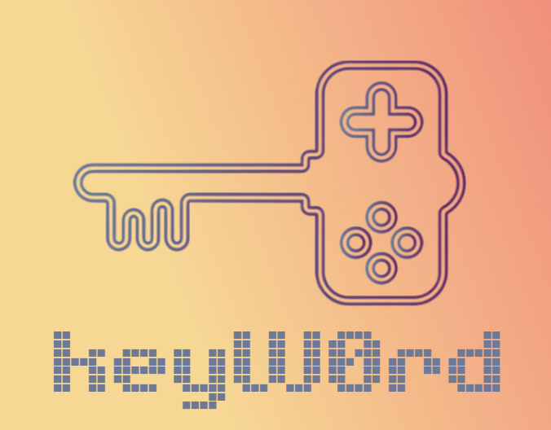

DedSec_2.0

Slide 2
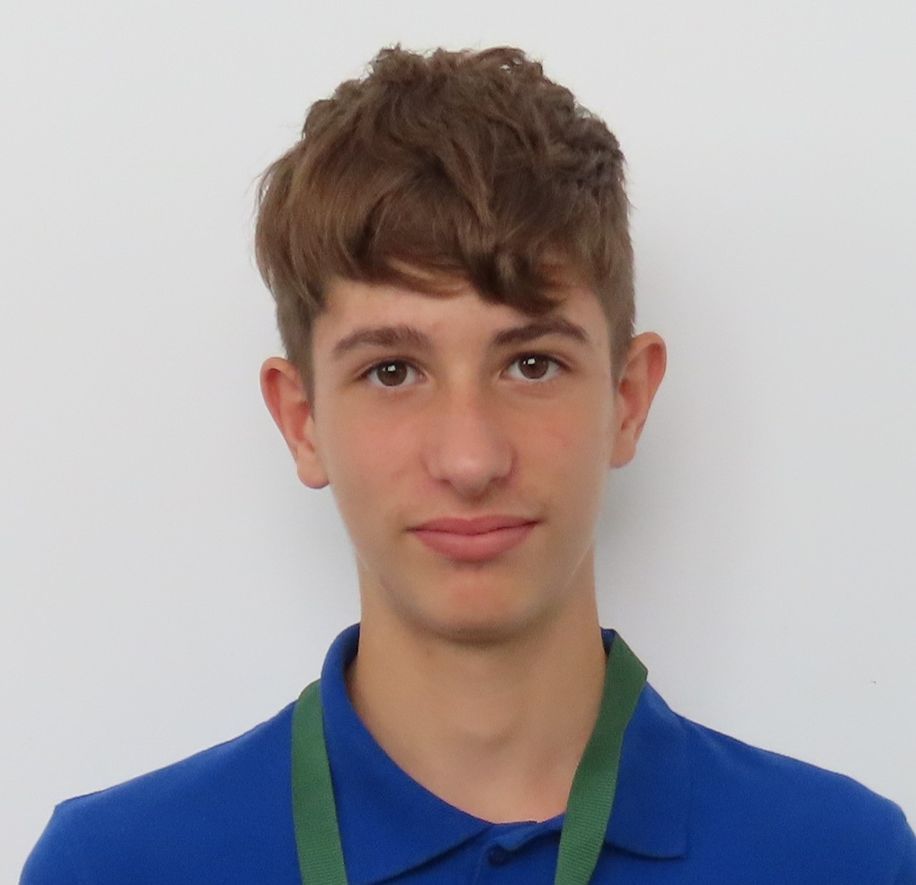
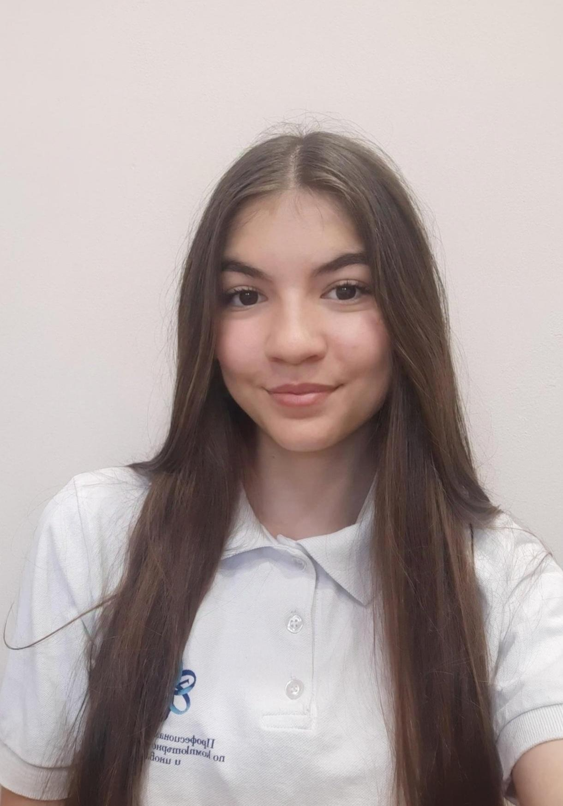
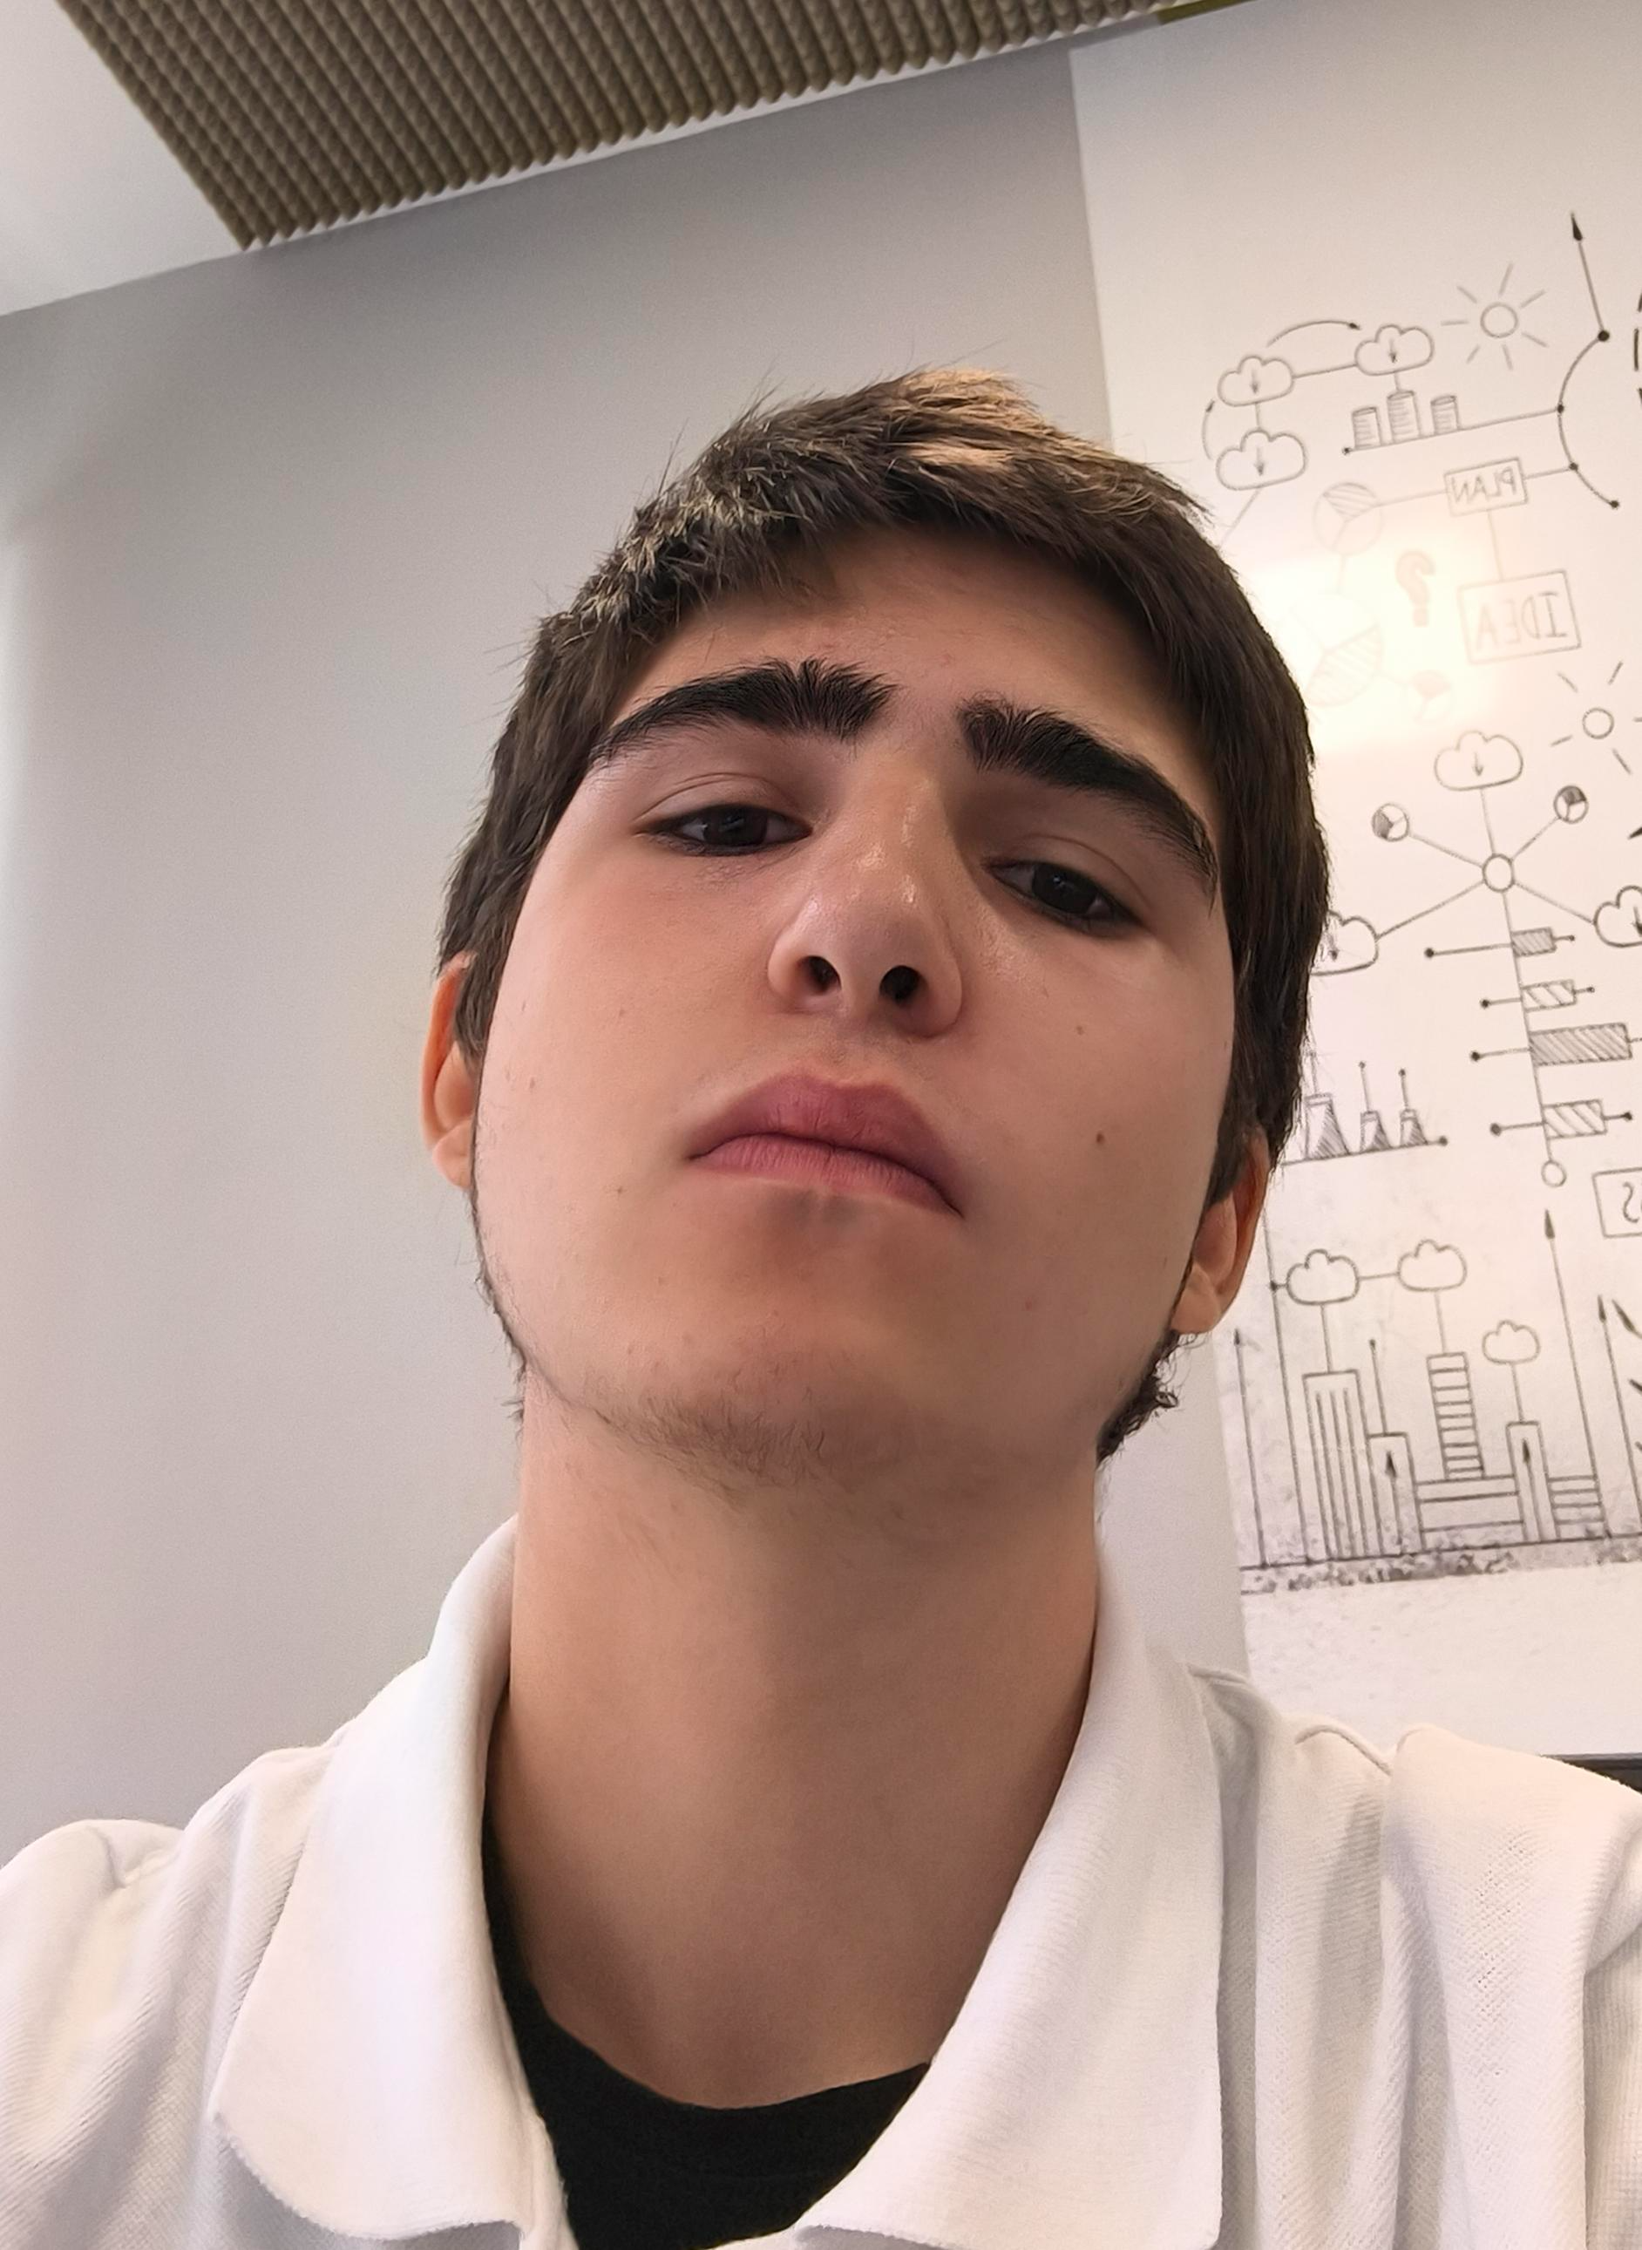
Our team​
Pavel Parvanov
Scrum Trainer
Rosica Parapanova
Designer
Milen Vasilev
Developer

Slide 3
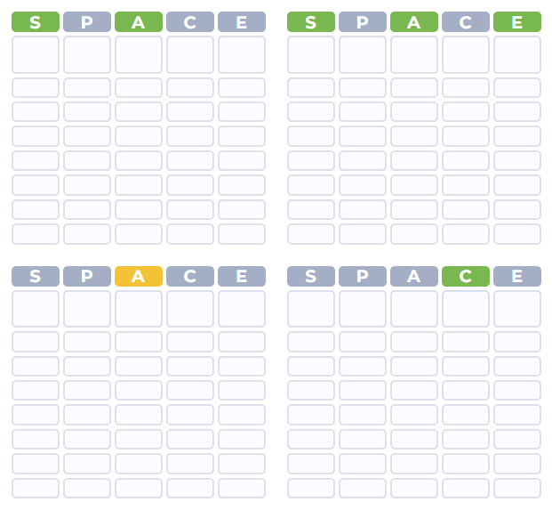
About our game​
“keyW0rd” is a word game in which you have 12 attempts to guess a
4 words made up of 5 letters. The game is entertaining and suitable for all ages.

Slide 4
Stages of progress
1st week
2nd week
3rd week
4th week
We were thinking about our logo and what game should we make
We were organizing meetings with our mentor
We started working on the project
We finished the project and made a presentation and documentation

Slide 5








Used Technologies

Slide 6
Thank you for the attention!

